Slide 1
Cairdio
Saif Khan , Ye Zhou, Rohitaa Ravikumar, Jade Huang

Slide 2
Table of Contents
Problem Statement
Current Solutions
Our Solution
Target Market
Implementation & Results
Notes:
In our presentation , for the first half we will talk about the problem we are trying to solve , what the current solutions are on the market , our proposed solution , what we did during the semester with our results and challenges faced and what we will do going forward

Slide 3
PROBLEM STATEMENT
Heart disease is the leading cause of mortality in the US, with one cardiovascular death every 33 seconds. [1].
Globally, cardiovascular diseases cause 17.9 million deaths annually, with over 80% due to heart attacks. Post-pandemic, there's a 30% increase in cardiovascular deaths among adults aged 25-44[2].
In order to diagnose heart diseases specialists such as doctors and cardiologists require extensive patient examination in order to diagnose.
Notes:
In the US, Leading cause of Mortality is due to heart disease, CDC states that every 33 seconds someone in the US dies from a cardiovascular disease . In 2021 , cardiovascular disease accounts for 1/5 deaths every year [1].
Globally each year 17.9 Million people die of various types of Cardiovascular Diseases and more than 4/5th’s of the deaths are due to heart attacks. Scientists have also observed a 30% increase in deaths due to cardiovascular disease after the pandemic in adults between ages of 25- 44 and more than 4/5th’s of the deaths are due to heart attacks[2].
In order to diagnose heart diseases specialists such as doctors and cardiologists require extensive patient examination in order to diagnose.

Slide 4
DIAGNOSE REQUIREMENTS
The diagnosis includes:
Current Symptoms
Patient Medical History
Conduct Physical Examinations
Perform diagnostic Tests such as ECG (Electrocardiogram)

Slide 5
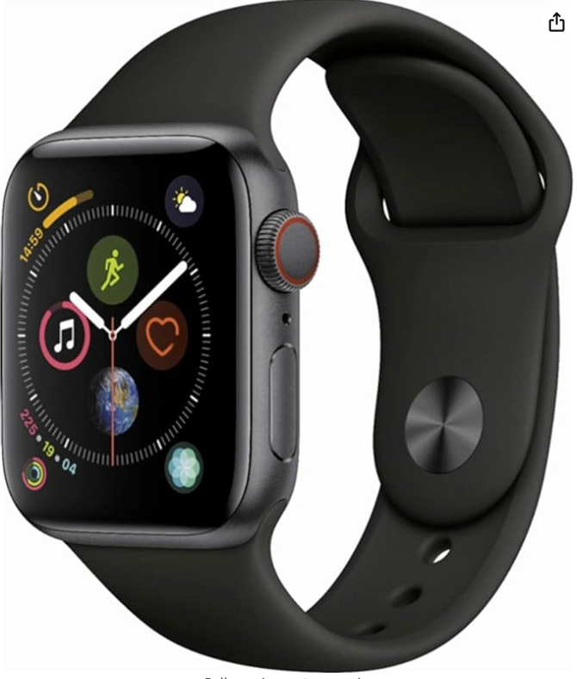
CURRENT SOLUTIONS WITH SOC AND AI
Current Examples of solutions that use a System on Chip with AI are:
Mayo Clinic's AI model with CNNs diagnoses hard-to-detect cardiovascular diseases with 86% accuracy, including left ventricular dysfunction.[3] .
Apple Watch utilizes Mayo Clinic's AI model for heart problem prediction.[3].
AI-based stethoscopes achieve 94% accuracy in detecting cardiovascular diseases, far surpassing the 44% accuracy of standard stethoscopes.[4].
Figure 1: Apple Watch uses AI model to detect Heart diseases.
Notes:
Mayo Clinic has developed AI technique using CNNs that can determine difficult to diagnose cardiovascular diseases. An example is left ventricular dysfunction diseases which can be detected using Mayo Clinics model with 86% accuracy[3] .

Slide 6
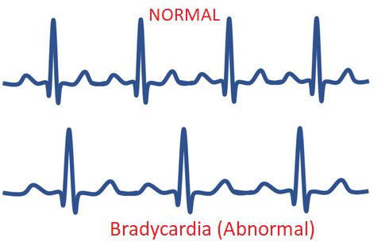
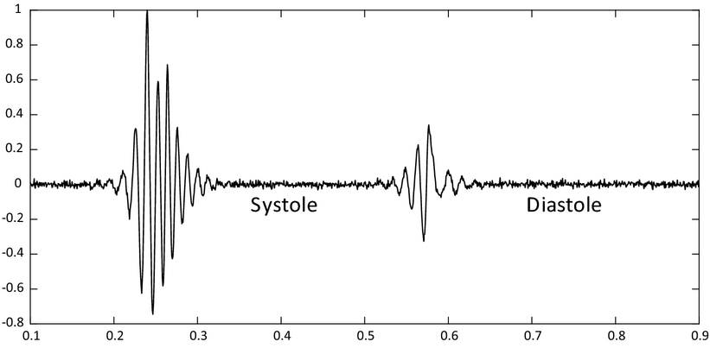
CURRENT SOLUTIONS WITH ECG & PCG
Current Methods to detect heart problems are ECG (Electrocardiogram) and PCG (Phonocardiogram)
ECG & PCG are non-invasive test measures .
ECG uses Electrical activity of the heart to determine heart problems. (Eg.Holter Monitor)
PCG uses sound activity of the heart to determine heart problems. (Eg. Stethoscope)
Figure 2: Example ECG Graph
Figure 3: Example PCG Graph

Slide 7
DISADVANTAGES OF USING SOC WITH AI
Specialist Interpretation: Data from devices like the Apple Watch require a cardiologist's expertise for accurate interpretation.
Cost Barrier: High cost of AI technology in devices may limit accessibility for lower-income individuals, leading to healthcare disparities.
Battery and Maintenance: Intensive monitoring and processing drain battery life, requiring frequent charging and maintenance.
Technological Dependency: Over-reliance on technology for health monitoring may reduce direct doctor-patient engagement and understanding of conditions.
Notes:
Miss Heart Problems: ECG & PCG miss heart problems that are not consistently present or have intermittent Symptoms. For Eg.Arrhythmias where heartbeat is irregular.
Requires a Specialist such as a cardiologist to interpret to data from an ECG or PCG.
Equipment is costly: ECG equipment is expensive and difficult to maintain and is not currently portable which makes it less accessible at low income areas.
PCG diagnosis alone is not reliable: PCG has limited sensitivity so it is not always able to detect subtle changes in heart sounds which make it less reliable.
Patient Factors: Obesity , lung disease, chest deformities can affect the quality of results.

Slide 8
DISADVANTAGES OF ECG
Intermittent Symptoms: ECG can miss heart problems like Arrhythmias that don't present consistently.
Specialist Interpretation: ECG data require analysis by a cardiologist.
High Cost and Maintenance: ECG equipment is expensive, hard to maintain, and not portable, reducing access in low-income areas.
Patient Factors: Obesity, lung disease, and chest deformities can impact the accuracy of ECG results.
Notes:
Miss Heart Problems: ECG & PCG miss heart problems that are not consistently present or have intermittent Symptoms. For Eg.Arrhythmias where heartbeat is irregular.
Requires a Specialist such as a cardiologist to interpret to data from an ECG or PCG.
Equipment is costly: ECG equipment is expensive and difficult to maintain and is not currently portable which makes it less accessible at low income areas.
PCG diagnosis alone is not reliable: PCG has limited sensitivity so it is not always able to detect subtle changes in heart sounds which make it less reliable.
Patient Factors: Obesity , lung disease, chest deformities can affect the quality of results.

Slide 9
TARGET MARKET
Cairdio is targeted towards healthcare providers like Rehab Therapists, Nurse Practitioners, Physician’s Assistants, Personal Care Aides and Physicians.
Misdiagnosis Prevention: Cairdio will help prevent misdiagnosis of heart issues by providing accurate detection technology for healthcare providers.
Earlier detection: Non-invasive and quick detection of issues will allow patients to receive proper treatment.
Portable & Affordable: The device is designed to be portable and available at low cost for a wide range of patients and healthcare providers.

Slide 10
OUR PROPOSED SOLUTION
Cairdio:
Uses Nordic NRF5340 SOC with Bluetooth
Collect heart beat data at 4 “doctor preferred” auscultation points using 4 microphones.
Data is collected over a period of 10 continuous seconds and transfers data using Bluetooth.
Noise Identification in the PCG signal to improve signal quality.
Our Solution: Enhance existing Cairdio Device
Use ESP32-S3-WROOM-2 with Bluetooth and WIFI capabilities
Use FPGA for high speed heartbeat data sampling and throughput from the microphones.
WIFI module will enable users to transfer data to cloud.
Automates the preprocessing step of identifying noise in the signal for further processing.

Slide 11
IMPLEMENTATION
Our Team is working on both hardware and software implementation of Cairdio:
Rohitaa Ravikumar (AI) → Corrupted Segment Detection
Ye Zhou (FPGA Implementation) → FPGA real time audio processing on Zedboard
Saif Khan (PCB Design) → Design a PCB that interfaces specifically with the Zynq 7000 FPGA on the Zedboard and initiate communication.

Slide 12
AI Implementation
Dataset
Data Preprocessing
Proposed Algorithm
Output
Final Result

Slide 13
Dataset
PhysioNet Challenge 2022
Comprehensive PCG dataset for cardiac murmur analysis
Diverse data from different cardiac regions
Human-expert labeled
Notes:
- Non-invasive assessment using digital stethoscopes to detect murmurs and clinical outcomes in pediatric populations.
- Dataset comprises heart sound recordings and demographic information for 1568 pediatric patients.
- Auscultation locations include pulmonary valve (PV), tricuspid valve (TV), aortic valve (AV), mitral valve (MV), and other (Phc).
- Two types of labels: murmur-related (presence/absence/unknown) and outcome-related (normal/abnormal).

Slide 14
Data Preprocessing
Preprocessing is crucial for optimizing heart sound signals, ensuring data quality for meaningful analysis.
Step 1: Remove spikes exceeding thrice the average amplitude.
Step 2: Mitigate baseline wandering using a high-pass Butterworth filter.
Step 3: Normalize the signal to ensure uniform representation of amplitudes.
Notes:
1. Removing Spikes:
- Spikes can be artifacts or outliers that may distort the signal and affect the analysis.
2. Mitigating Baseline Wandering:
- To remove slow/ low frequency variations in the signal over time.
3. Normalizing Signal:
- Normalize the signal against its standard deviation.
- Makes the signal comparable and improving overall signal quality.

Slide 15
Proposed Algorithm
Step 1: The minimum window length is two cycles of the heart sound signal. The signal is segmented into windows of a specified duration i.e., 8s.
Step 2: Calculate the quality index for the windowed subsequence.
Step 3: Slide the window with step size of 0.1s and calculate the quality index for the next windowed subsequence until the window reaches the end of the sequence to capture local variations.
Notes:
Heart sounds result from heart valve closure, blood flow, and cardiac muscle contractions, repeating in each cardiac cycle.
Hence exhibits cyclostationary behavior, with consistent cycle duration reflecting gradual changes in heart rate.
The quality index quantifies the degree of periodicity in the signal.
Higher quality index corresponds to a signal with less noise, making it more periodic and reliable for analysis.
Mathematical representations using cyclic correlation functions and spectral density provide insights into the cyclostationarity of the signal.
Cyclic correlation functions help understand the periodicity in the signal over time.
The cyclic correlation function measures the correlation between the signal at two different time instances separated by a time delay.
The spectral density is obtained by applying the Fourier transform to the cyclic correlation function.

Slide 16
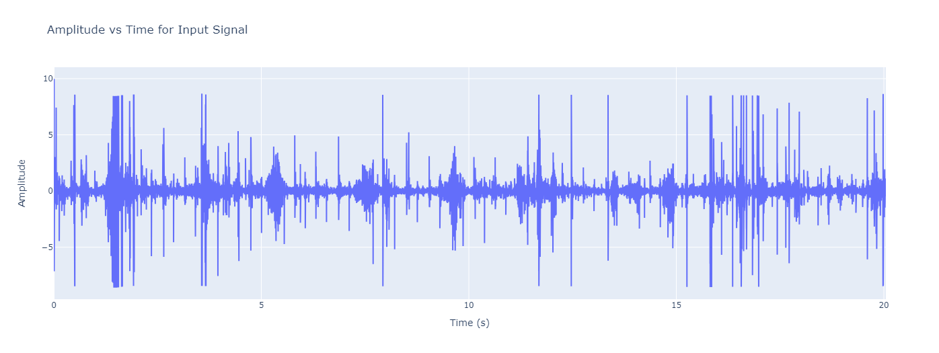
Plot for Input Signal

Slide 17
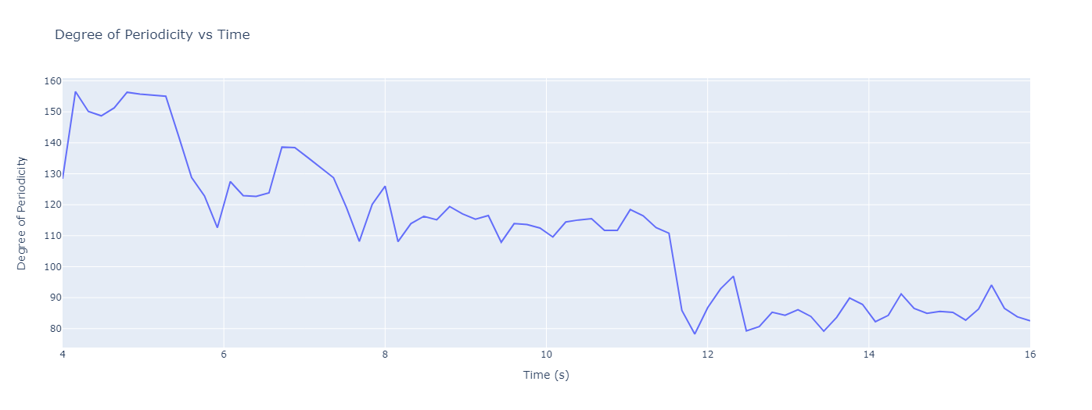
Output of the Proposed Algorithm

Slide 18
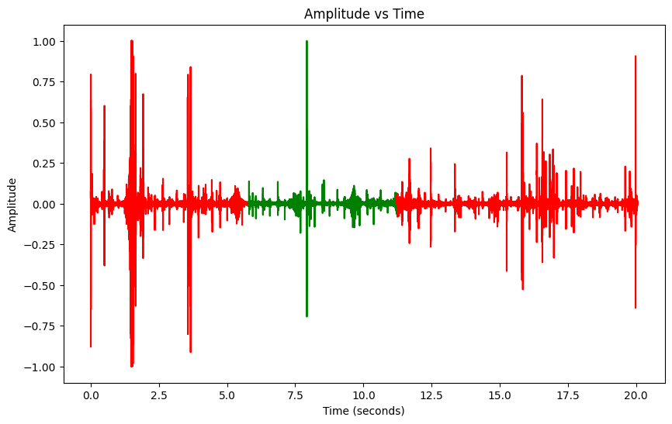
Color Coded Input signal
Red - Noisy Segment
Green - Clean Segment

Slide 19
Binary Mask from Degree Peaks
The threshold for the degree peak values to generate the binary mask is set at 35%,
Values below this threshold are considered noise, and those equal to or above 35% are regarded as the clean signal.
Binary mask : Clean segment is denoted by 1, noisy segment is signified by 0.

Slide 20
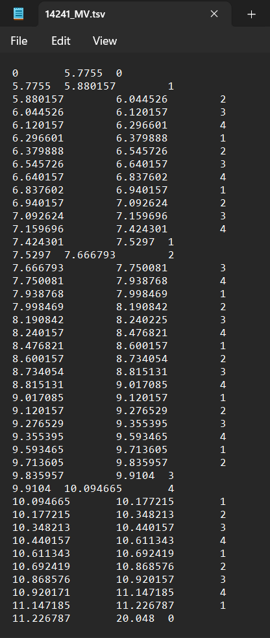
Binary Mask from labels
The tsv files in the dataset contains 3 columns:
Start_time
End_time
Labels
The third column has following values :
The S1 wave is identified by the integer 1.
The systolic period is identified by the integer 2.
The S2 wave is identified by the integer 3.
The diastolic period is identified by the integer 4.
The unannotated segments of the signal are identified by the integer 0.
Notes:
1. S1:
- S1 is the first heart sound heard during the cardiac cycle.
- It is commonly referred to as the "lub" sound.
- S1 is associated with the closure of the atrioventricular (AV) valves.
2. S2:
- S2 is the second heart sound and is often described as the "dub" sound.
- S2 is associated with the closure of the semilunar valves, namely the aortic and pulmonary valves.
3. Systolic Wave:
- The systolic phase of the cardiac cycle corresponds to the contraction of the heart chambers (ventricles).
- The systolic wave on a phonocardiogram represents the entire period from the onset of ventricular contraction (S1) to the closure of the semilunar valves (S2).
4. Diastolic Wave:
- The diastolic phase of the cardiac cycle is the relaxation period when the heart chambers (ventricles) are filling with blood.
- The diastolic wave on a phonocardiogram represents the entire period from the closure of the semilunar valves (S2) to the onset of the next ventricular contraction (S1).

Slide 21
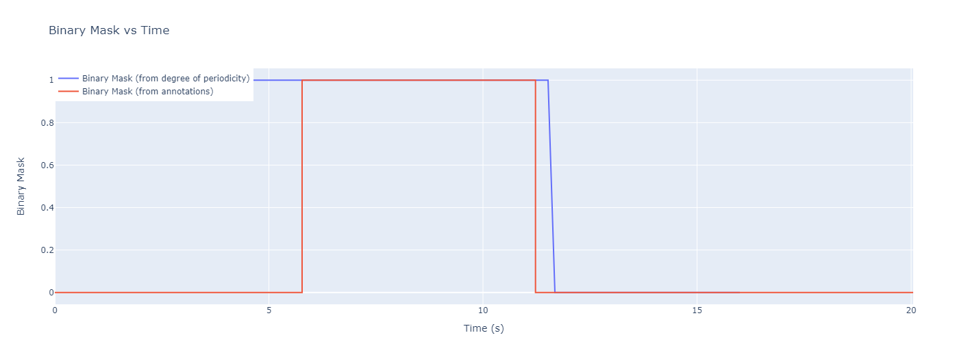
Binary Mask Plot

Slide 22
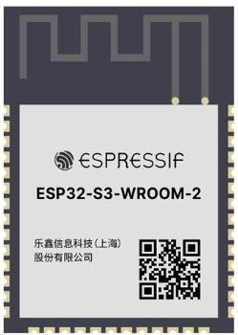
Printed Circuit Board Design
The PCB is designed for the ESP32-S3 -WROOM-2- N32R8V System-on-Chip.
The purpose of the design was to create a setup interface between the SOC and the Zynq 7000 FPGA.
Since the Chip contains 33 GPIO pins out of 40 pins not all of them are necessary .
Design Contains UART, I2C, SPI and USB OTG interfacing methods. DIFF SPI for MicroSD Connection.
Contains 512kB RAM and the only S3 chip with 32MB Flash Memory.
Figure 1: ESP32-S3-WROOM-2 Chip.

Slide 23
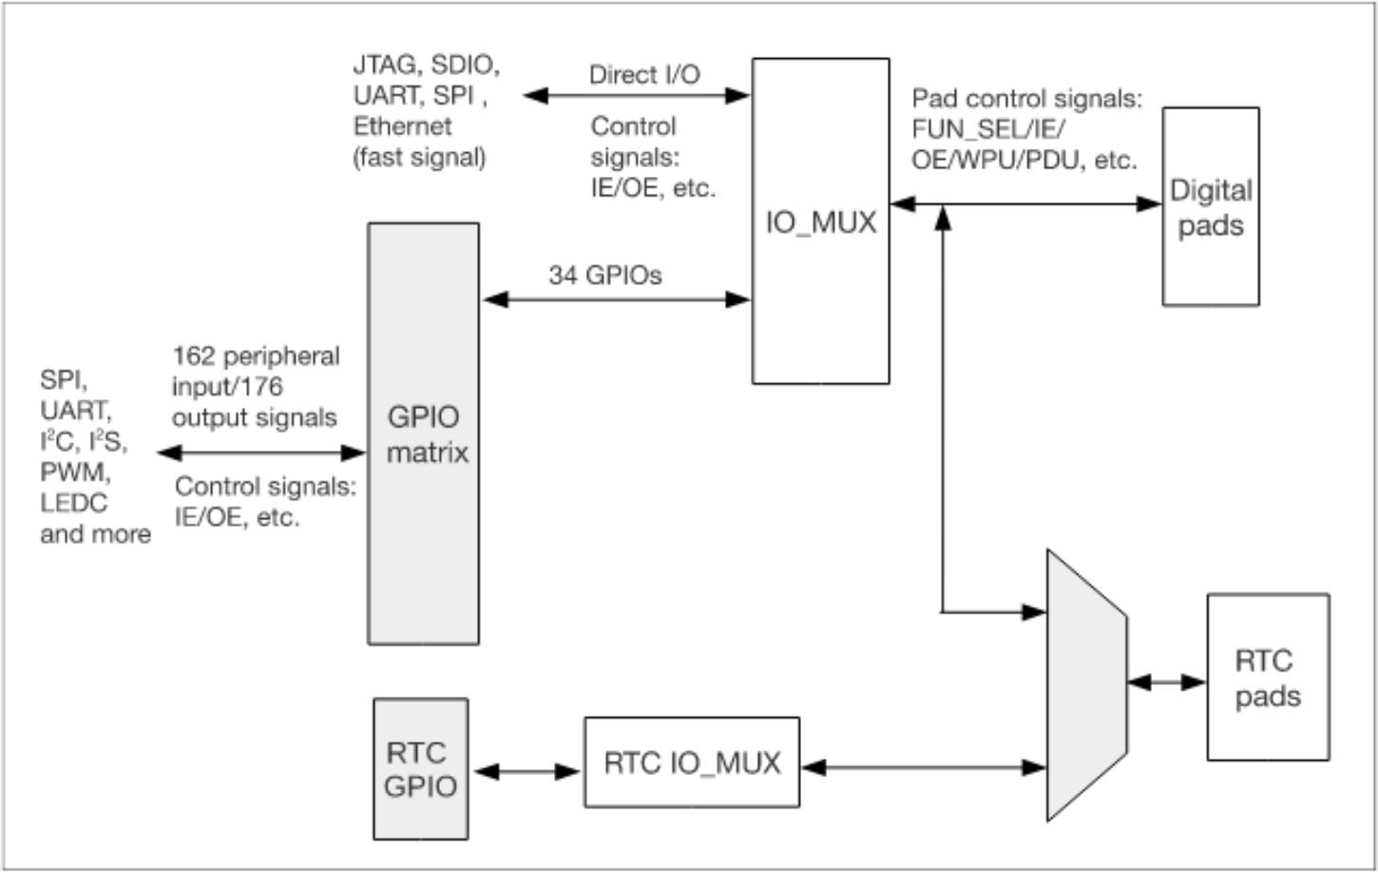
GPIO MATRIX
Each pin in the GPIO Matrix can be used as a general-purpose I/O, or be connected to an internal peripheral signal.
Through GPIO matrix uses IO_MUX to designate special pin functions such as for example ADC , SPI or regular GPIO Pin configuration and peripheral input.
RTC GPIOs are for LOW Power Applications .GPIO Matrix uses RTC_IO_MUX (Real Time Clock) to be configured for Ultra Low Power Applications and Activate Sleep modes for the IC not done on regular pins.
Figure 2: GPIO Matrix for ESP32S3 [6].

Slide 24
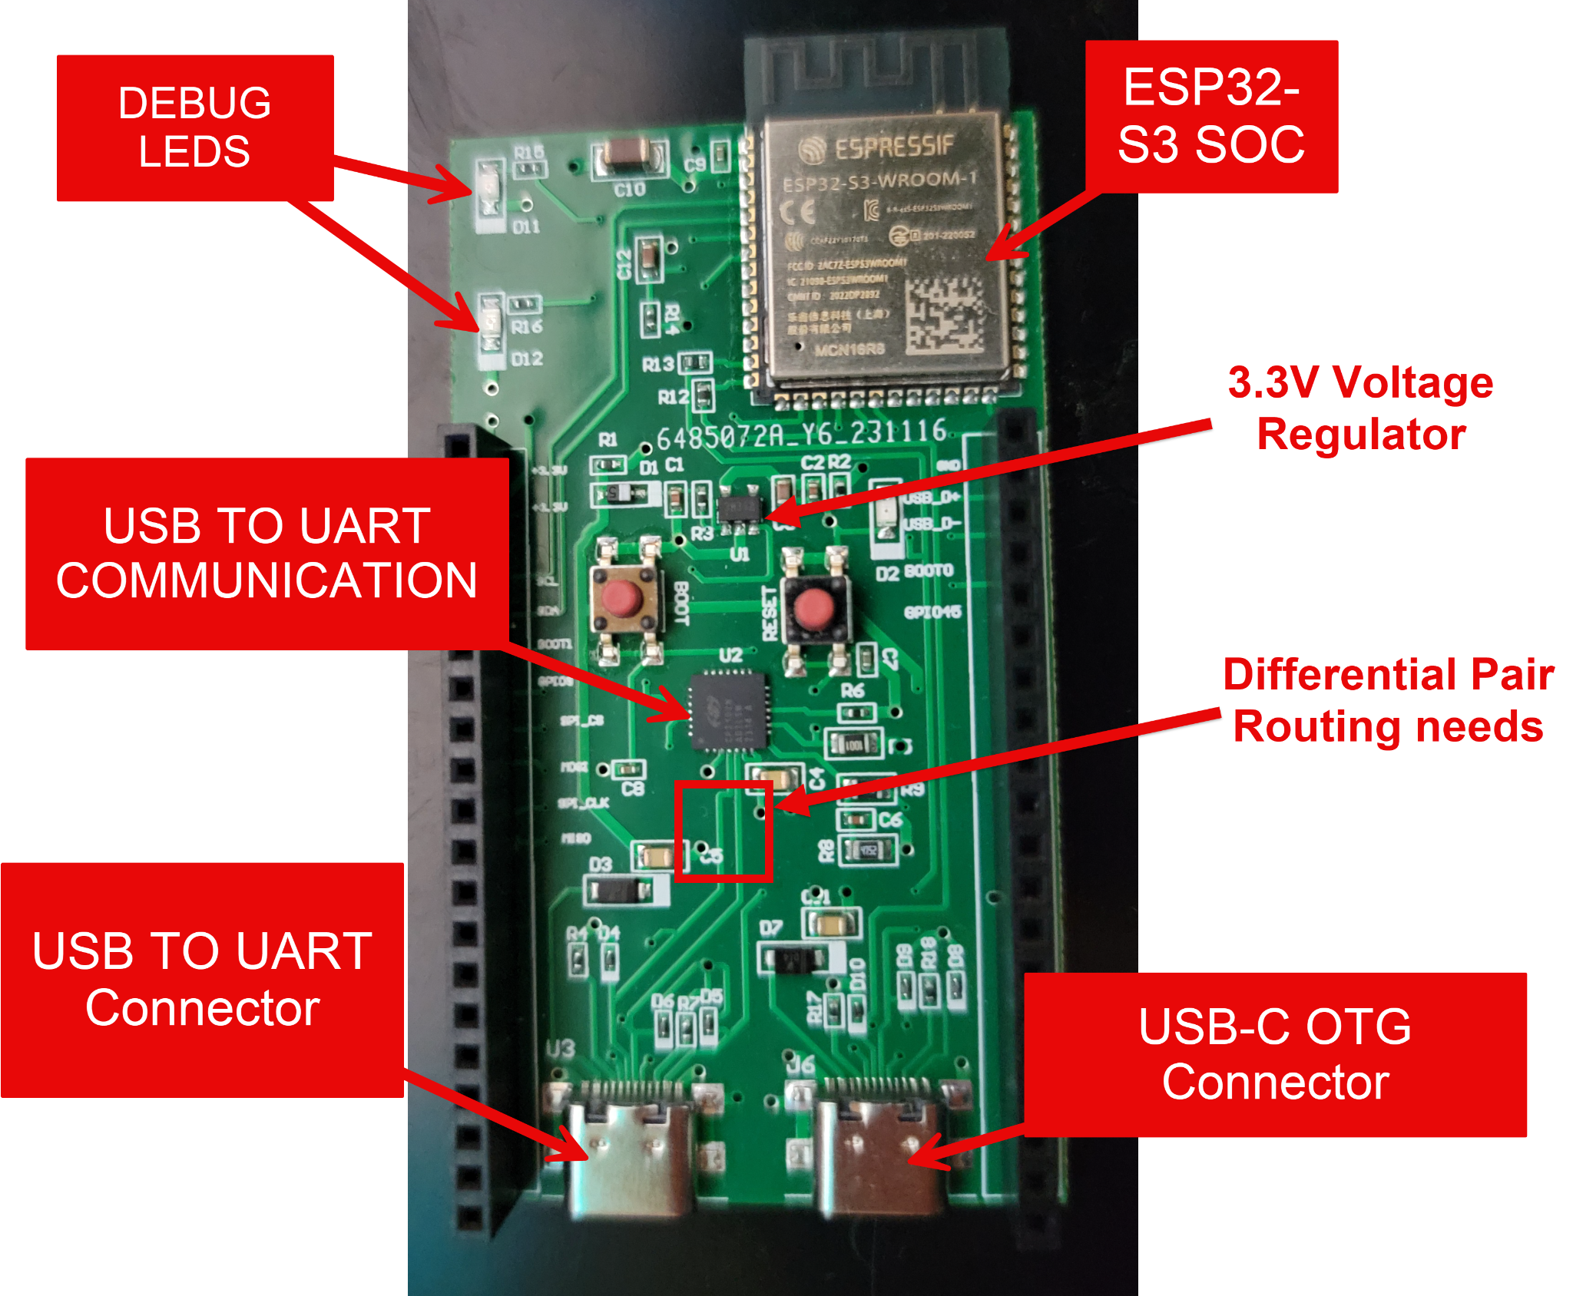
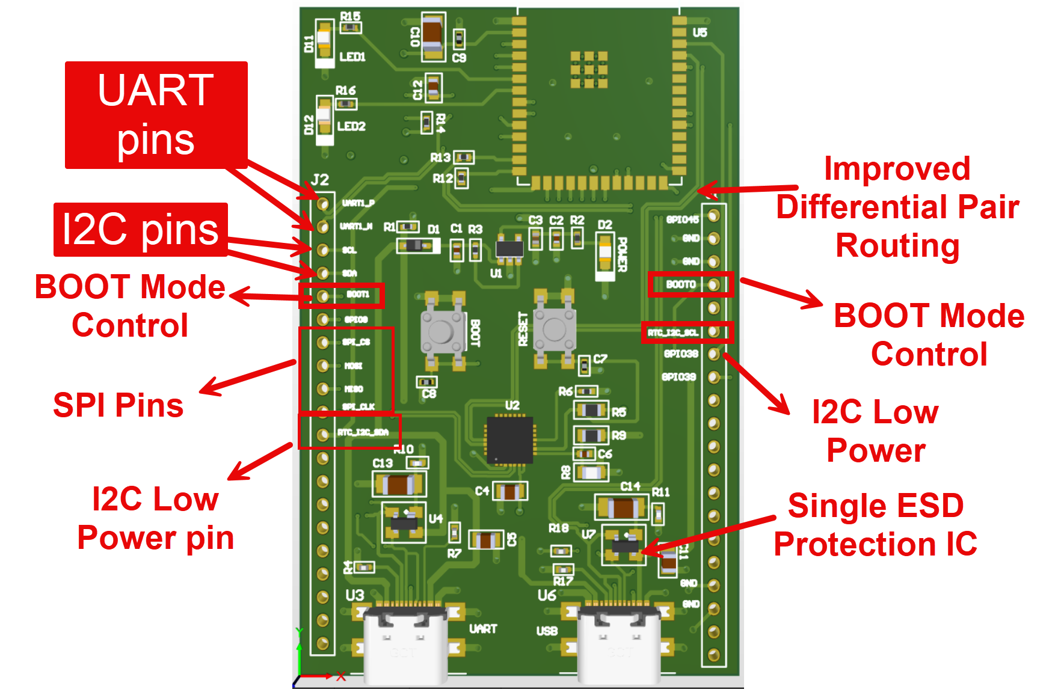
PCB Version 1 and 2 Comparison and Features
Figure 2: Version 1 PCB (Front).
Figure 3: Version 3 PCB Altium (Front).

Slide 25
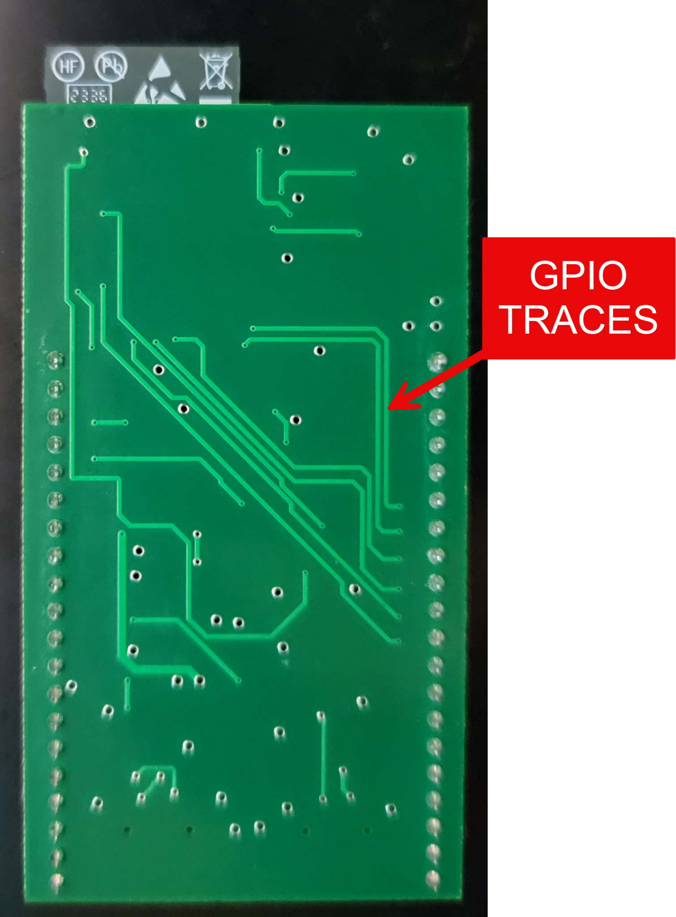
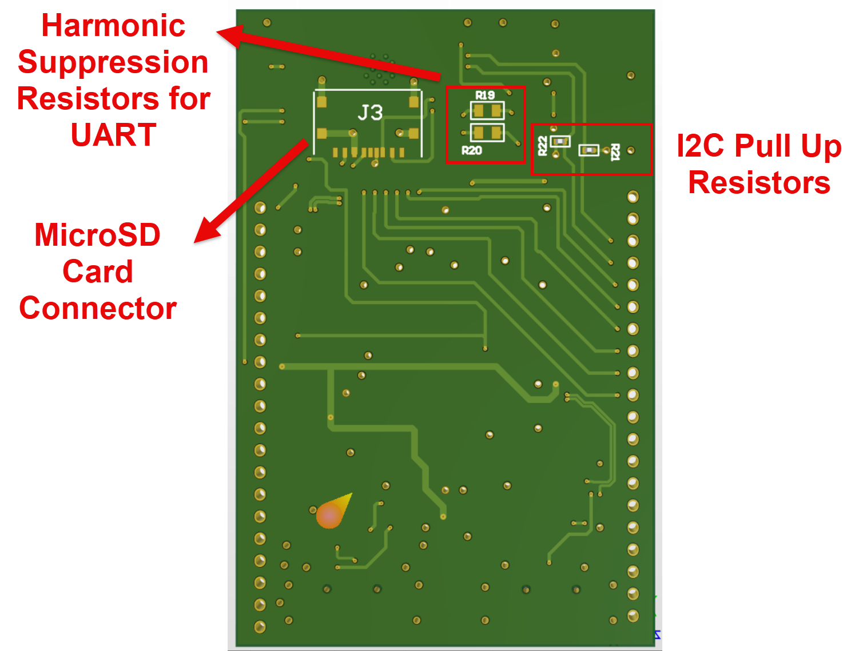
PCB Version 1 and 2 Comparison and Features
Figure 4: Version 1 PCB (Back).
Figure 5: Version 2 PCB Altium (Back).

Slide 26
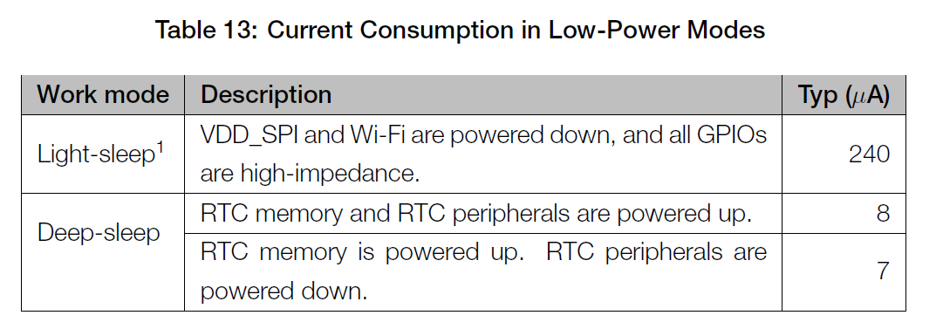
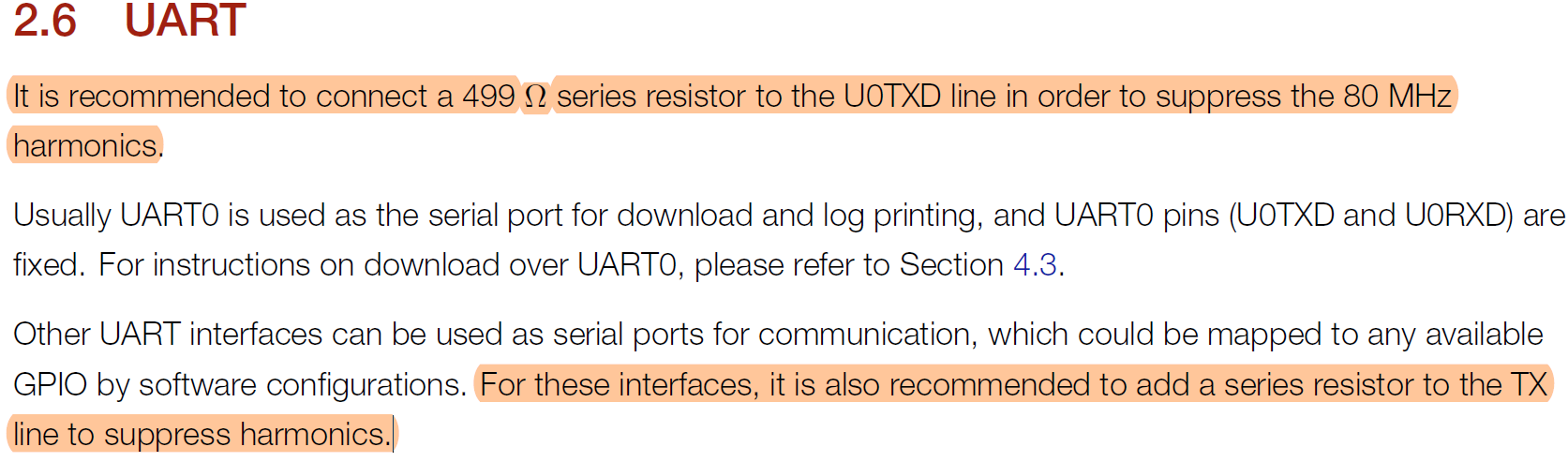
CONFIGURATIONS FOR COMMUNICATION
In order for the communication methods to work effectively , several guidelines are needed:
I2C = Contains 2 Lines only . Pullup resistors (5.1k) on SDA and SCL lines typically depend on the total capacitance of the bus [4]. This was not done for the RTC_I2C pin due to high impedance state in Light Sleep mode.
SPI = Contains 4 Lines. Easiest to setup as no additional hardware is required.
UART = Contains 2 Lines, Requires Harmonic Resistors on the Lines.
Figure 6: RTC Pin Configuration. [ESP S3 datasheet]
Figure 7: UART Pin Configuration.[ESP S3 datasheet]

Slide 27
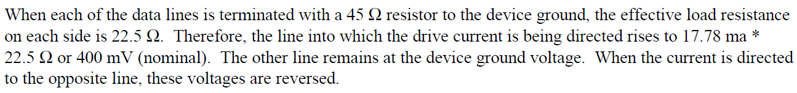
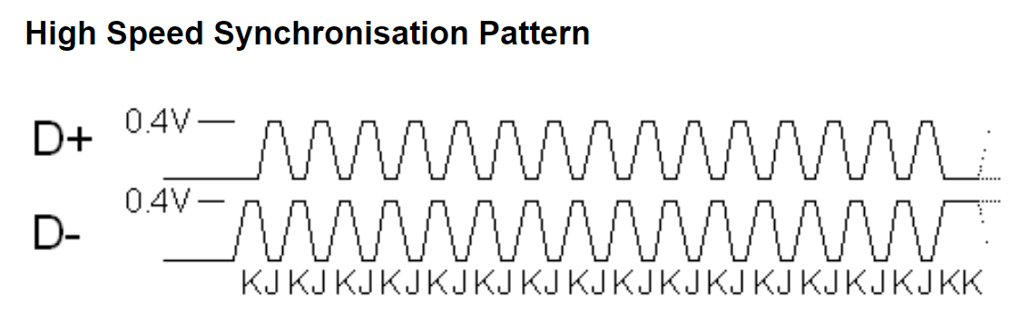
CONFIGURATIONS FOR COMMUNICATION
For USB OTG mode, the Data + and Data - Lines requires 45 Ohm resistors on each line.
My design actually used 22.6 Ohm resistors.
In differential mode, the effective voltage difference between D+ and D- is 2×V = I*45 , since the voltage drop on one line adds to the voltage rise on the other.
This makes it seem as if there's a single resistor with twice the voltage drop, which mathematically is equivalent to a resistor with half the resistance (22.5 Ohms) and the same voltage drop
Figure 8: USB 2.0 Spec Termination Resistor. [USB 2.0 Specification Pg 129].
Figure 9: Typical Data Pattern for USB Signal. [Source: USB Made Simple].

Slide 28
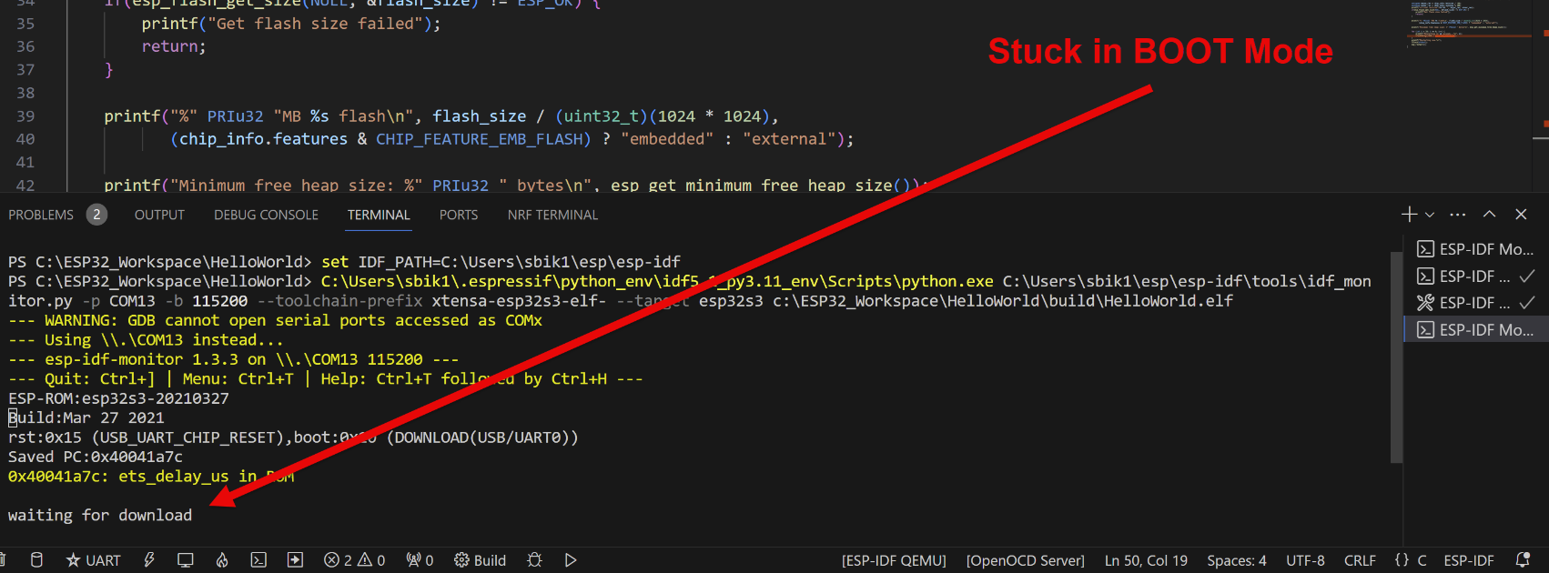
ISSUES DURING TESTING
During the firmware test, the Firmware during Flash Process would get stuck in boot mode.
The program would successfully flash to the IC but during startup it would not be able to get the new image.

Slide 29
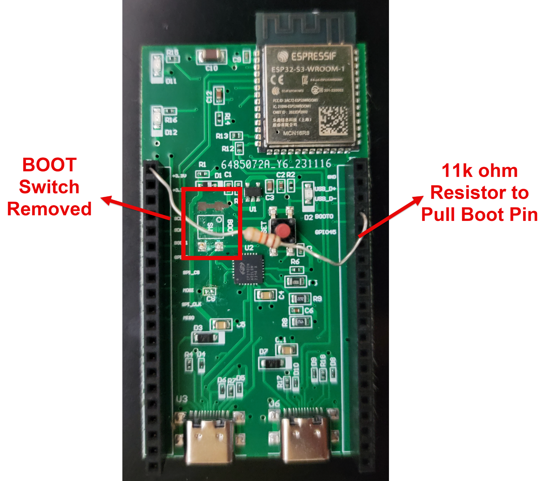

Successfull Flash of Program
During the firmware test, the Firmware during Flash Process would get stuck in boot mode.
The issue was that the BOOT Switch pulled the boot pin to the ground and would not pull it back high. Error in my schematic.

Slide 30
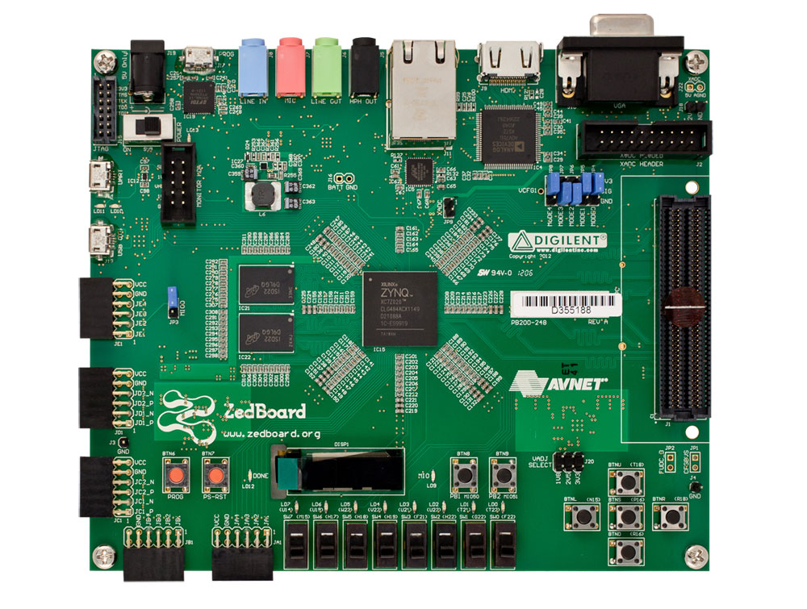
FPGA SELECTION
Crucial to choose an FPGA with enough power and resources for efficient audio processing.
FPGA needs compatibility with Xilinx Audio I2S interface for smooth integration.
ZedBoard Zynq-7000, fulfilling these criteria, is the optimal choice for our audio processing system's core to run real-time audio algorithms.
Notes:
Purpose using FPGA: make the real time audio signal processing more efficient, have pre-processing signal before sending to AI model.
Selecting an FPGA with sufficient processing power and resources is crucial for efficient audio data processing. The FPGA must also be compatible with the Xilinx Audio I2S interface for seamless integration. The ZedBoard Zynq-7000, meeting these requirements, is the ideal choice for the heart of our audio processing system, where it will execute real-time audio algorithms.
In our system, the ADAU1761 audio Codec chip on the ZedBoard handles audio processing. Configured through the I2C bus, this chip uses its two Analog-to-Digital Converters (ADCs) to sample stereo audio at 48kHz. These digital samples are then sent to the Zynq chip via the I2S audio bus for additional processing.
The Zynq chip features a Numerically Controlled Oscillator (NCO) that generates sine wave samples at specific frequencies. These samples are superimposed on the incoming audio, creating a composite stream. This mixed audio is sent through the I2S bus to the Codec's DACs and played on a speaker or earphone connected to the chip's line-out port. - for noise cancellation and LPF/HPF

Slide 31
IMPLEMENTATION INTRODUCTION
Digitized audio samples are sent to the Zynq chip via the I2S bus, using the Zed_audio_ctrl IP core for interface implementation.
The Zynq chip's NCO generates sine wave samples at selected frequencies, which can be merged with audio samples using Zedboard switches.
Modified audio (original + sine wave) is played through speakers or earphones connected to the ADAU1761 Codec's DAC via the line-out port (green plug).
Input audio can come from a microphone or a desktop/laptop's analog output (blue plug).
Notes:
In our system, the ADAU1761 audio Codec chip on the ZedBoard handles audio processing. Configured through the I2C bus, the zedboard uses its two Analog-to-Digital Converters (ADCs) to sample stereo audio at 48kHz. These digital samples are then sent to the Zynq chip via the I2S audio bus for additional processing.
NCO - Numerically Controlled Oscillator- Credit to the Zynq Book Team, used to generate a sine wave at a desired frequency (within the audible range)
The Zynq chip features a Numerically Controlled Oscillator (NCO) that generates sine wave samples at specific frequencies. These samples are superimposed on the incoming audio, creating a composite stream. This mixed audio is sent through the I2S bus to the Codec's DACs and played on a speaker or earphone connected to the chip's line-out port.
ADAU1761 Codec, a complex chip with two 24-bit ADCs and DACs, supporting a wide 8KHz to 96KHz sampling range.

Slide 32
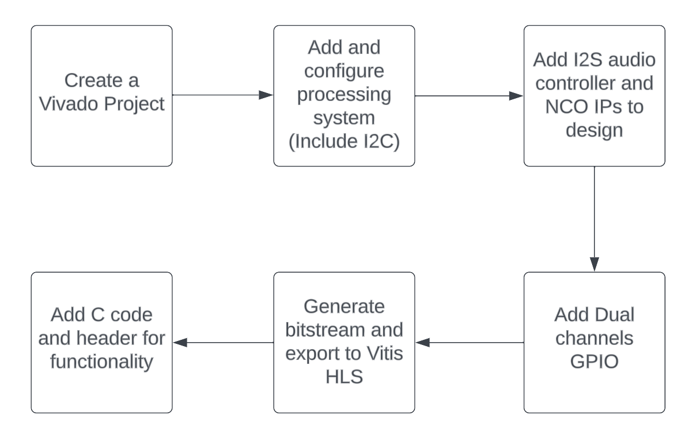
FPGA AUDIO PROCESSING FLOWCHART
Notes:
I2S and NCO block: import from Zynq book resource
GPIO: for LEDs and switches on Zedboard
The Vitis™ HLS tool allows users to easily create complex FPGA algorithms by synthesizing a C/C++ function into RTL.

Slide 33
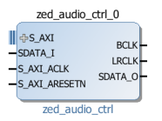
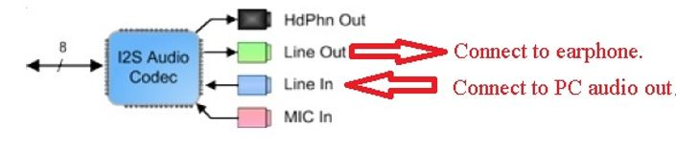
I2S Introduction
Inter-IC Sound (I2S) Protocol - an electrical serial bus interface standard used for connecting digital audio devices together
The Left-Right clock (LRCLK)
Bit clock (BCLK) - Serial Clock
Serial audio data in/out lines (SDATA_ADC) and (SDATA_DAC)
Use zed_audio_ctrl block from Zynq book[7]
Notes:
LRCLK: identify the audio system sample rate and frame the two channels of audio data that exist on the single audio data line.

Slide 34
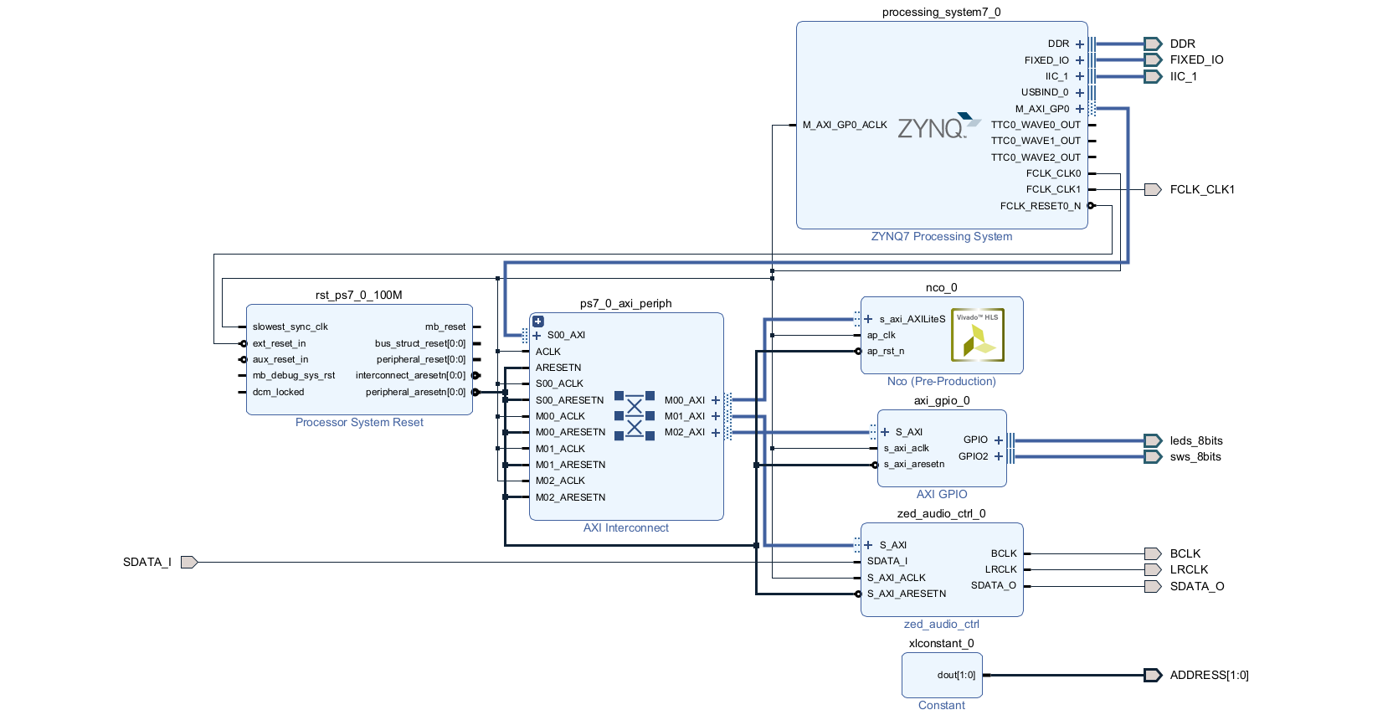
VIVADO BLOCK DESIGN OVERVIEW
Notes:
The system features a ZedBoard with an ADAU1761 Codec chip, having 24-bit ADCs and DACs for audio, supporting 8kHz to 96kHz sampling. It samples stereo audio at 48kHz and sends it to the Zynq chip via 'zed-audio-ctrl' IP core. The Zynq chip uses an NCO to generate sine waves, merged with audio via ZedBoard switches. The mixed signal goes through the I2S bus to the Codec's DACs for output. It accepts inputs from microphones or analog sources.
Make sure FCLK_CLK0 = 100 MHz, FCLK_CLK1 = 10 MHz

Slide 35
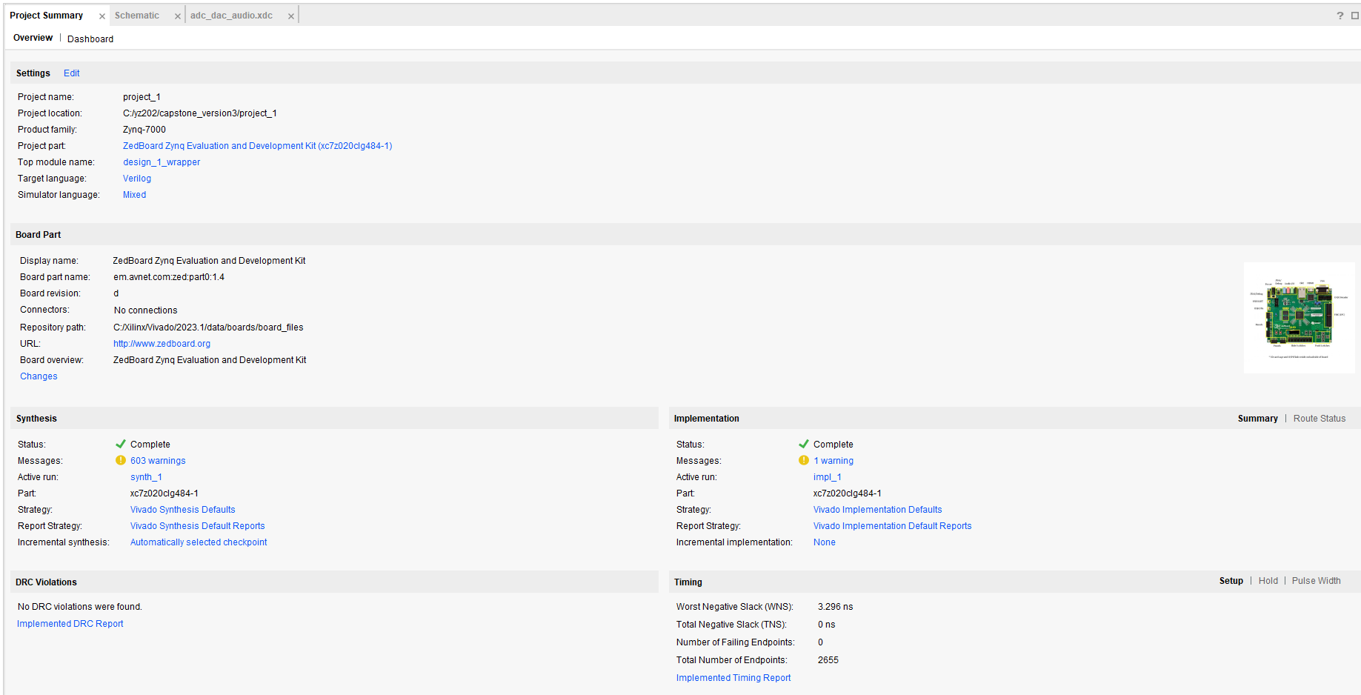
VIVADO SIMULATION RESULTS
Notes:
Export the hardware with bitstream

Slide 36
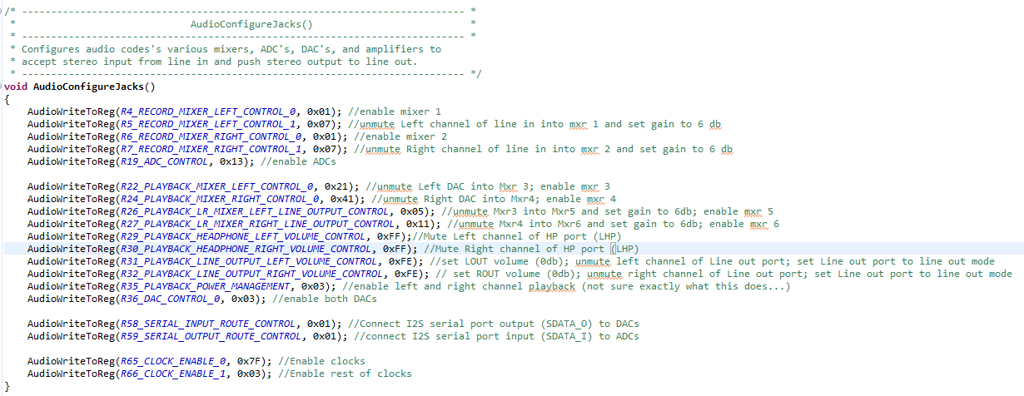
VITIS HLS IMPLEMENTATION
Add C code for control registers
Notes:
The setup for the ZedBoard audio codec will be explained, involving hardware registers. Each IP peripheral added in IP Integrator automatically receives a base memory address, available in a Xilinx C header file created with Zynq Processing System designs. Also, I've developed functions to initialize the audio codec and I2C interface in the Zynq Programmable logic.

Slide 37
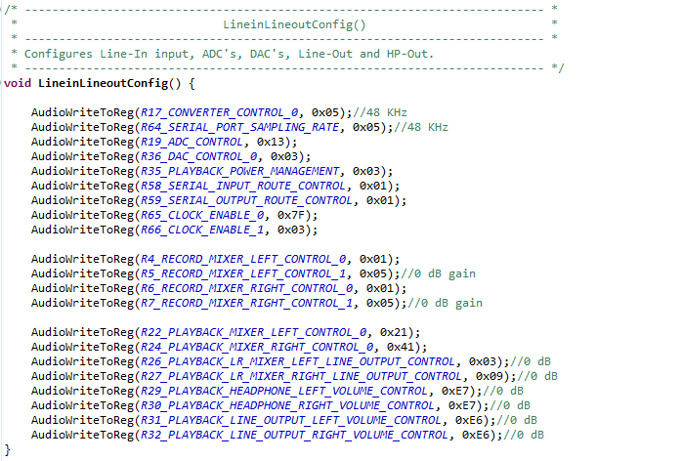
VITIS HLS IMPLEMENTATION
Add C code for control registers

Slide 38
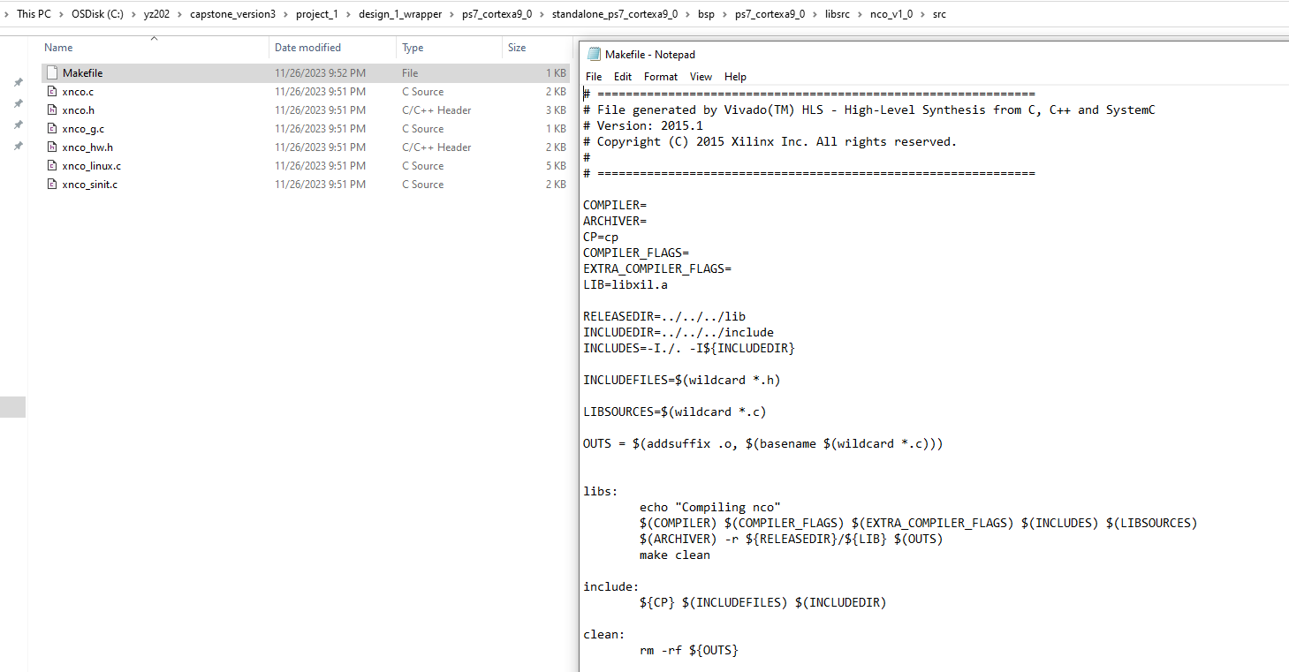
PROBLEMS SOLVED
Change makefile for building the project.
Notes:
Change it for NCO block since it’s not from default library. - since the vitis we’re using are the newest version.
Also make sure there are drivers in this repository for import blocks(I2S and NCO).

Slide 39
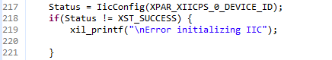
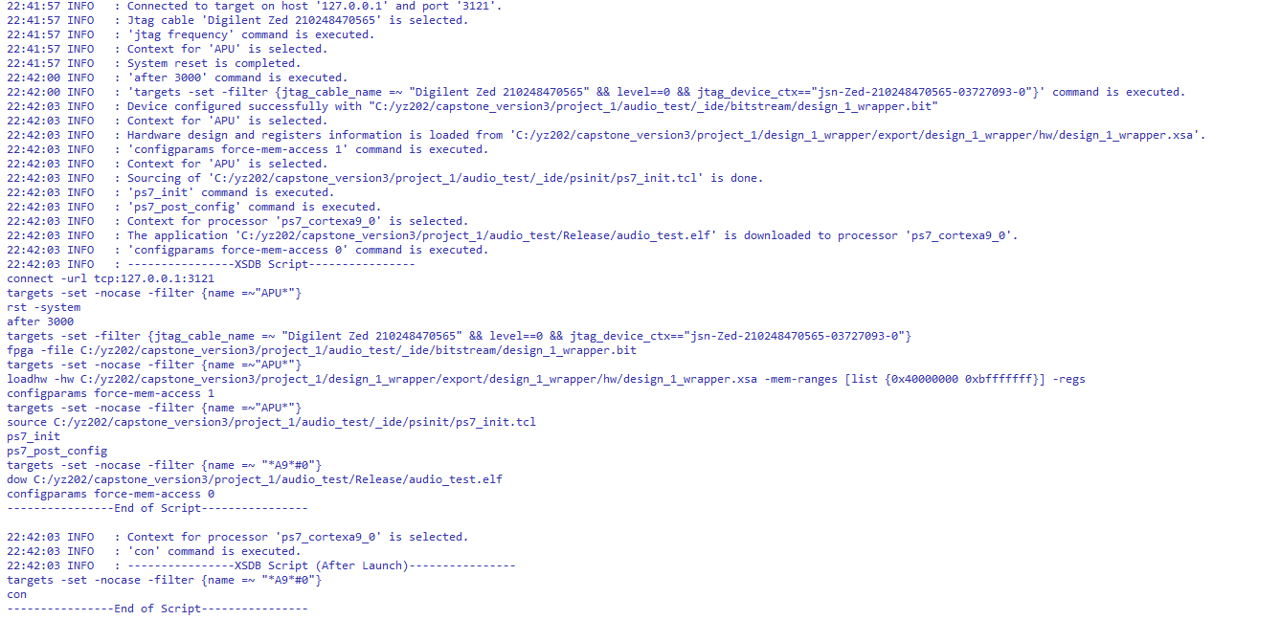
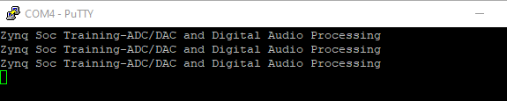
VITIS RESULT

Slide 40
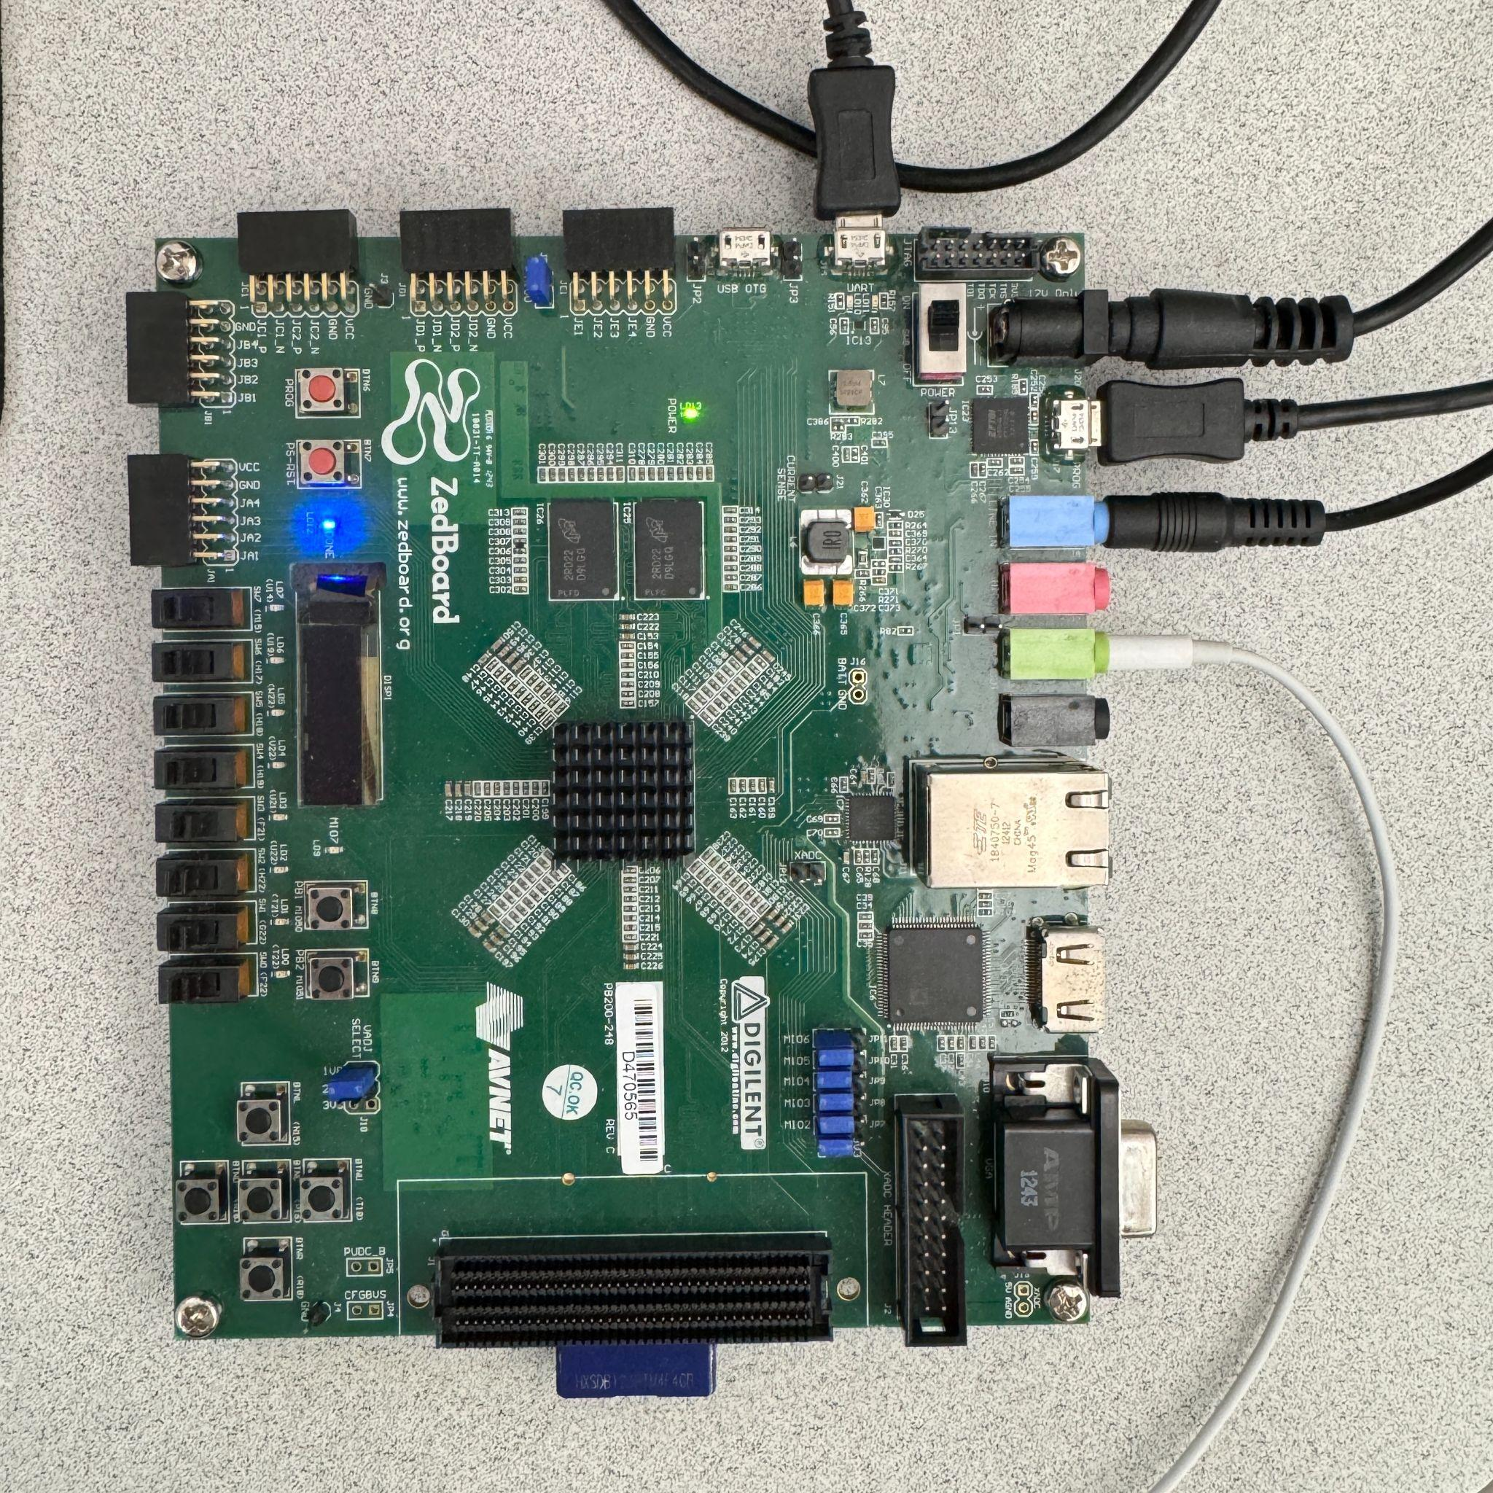
ZEDBOARD CONNECTION
3.5mm male to male connector - to PC
Headphone
Notes:
Using the Zedboard's switches, you can mix sine waves into audio played through a speaker. The Zynq chip processes this digital audio data, adding sine waves, and sends it back to the ADAU1761 Codec. Finally, the ADAU1761's DAC converter blends the original audio with the sine waves and outputs this mixed analog signal to the earphone.

Slide 41
References
I. V. (2023, December 11). Impact of COVID-19 on Cardiovascular Disease. Center for Disease Control. Retrieved December 6, 2023, from https://www.who.int/news-room/fact-sheets/detail/cardiovascular-diseases-(cvds)#:~:text=Cardiovascular%20diseases%20(CVDs)%20are%20the,%2D%20and%20middle%2Dincome%20countries.
Yeo, D. H. (2023, October 22). COVID-19 Surges Linked to Spike in Heart Attacks. Retrieved December 6, 2023, from https://www.cedars-sinai.org/newsroom/covid-19-surges-linked-to-spike-in-heart-attacks/
A. H. A. (2023, November 6). AI may accurately detect heart valve disease and predict cardiovascular risk. Retrieved December 6, 2023, from https://newsroom.heart.org/news/ai-may-accurately-detect-heart-valve-disease-and-predict-cardiovascular-risk
https://www.nxp.com/docs/en/user-guide/UM10204.pdf
Ting Li, Tianshuang Qiu, Hong Tang, “Optimum heart sound signal selection based on the cyclostationary property”, Computers in Biology and Medicine, Volume 43, Issue 6, 2013, Pages 607-612, ISSN 0010-4825.
https://espressif-docs.readthedocs-hosted.com/projects/arduino-esp32/en/latest/tutorials/io_mux.html
ZedBoard Audio in Vivado IP Integrator: https://www.fpgakey.com/tutorial/section401

Slide 42
THANK YOU FOR LISTENING

